Slide 1
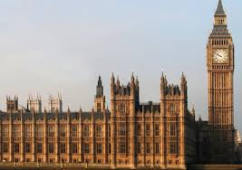
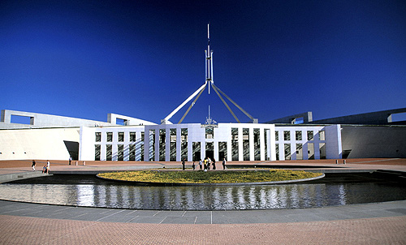
The Westminster system
L.G: We will learn about the origins and key features of the Westminster system in Australia.
C.S: 1- Glossary has all new key terminology neatly added.
2-We will understand some of the key features of the Westminster System of Government.

Slide 2
PowerPoint expectations
If the text is in BLUE then you need to copy it down.
If the text is in RED then it is a task to do.
If the text is in GREEN then it is a discussion point.

Slide 3
The Westminster system – key questions
Where did it originate?
Why does Australia use it?
What are some of the key features?

Slide 4
Glossary
Term | Definition
The Westminster System | The system of Parliament which is based off the system of government in Great Britain
Responsible Government | When a government is accountable for its actions to Parliament.
Bicameral
Unicameral | When there is only one house of Parliament such as in Queensland, the Northern Territory and the Australian Capital Territory.
When there are two houses of Parliament such as the House of Representatives and The Senate.

Slide 5
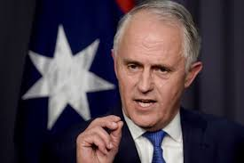
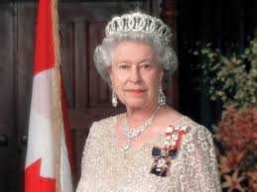
What do we know about the following ?
Parliament
Prime minister
The Queen /King
The Governor General
Write down each of these words and anything you know about them. Then share with the person next to you. Be prepared to share with the class.
Notes:
Put these terms on board – have students brainstorm what they know about them – put responses on the board

Slide 6
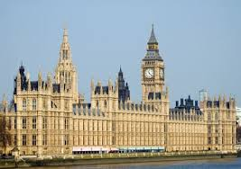
The origins of the Westminster system
The Westminster System takes it name from the Palace of Westminster, in London, Britain where the Model Parliament of 1295 was held.
England’s Houses of Parliament are still at the Palace of Westminster.

Slide 7
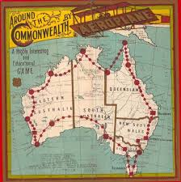


Why we have this system
As a colony of Britain we have adopted the same system of Government that they use.
When Australia federated in 1901 they created the Commonwealth Parliament, made up of two houses (bi-cameral) the lower house follows the same structure as Britain’s House of Commons and then we have an upper house known as The Senate which is modelled on the American Senate.
We have the same head of state as Britain – this is the Monarch (Queen Elizabeth) except in Australia she is represented by the Governor General.

Slide 8
Australian parliament - recap
Parliamentary Education Office – What is Australian Parliament?
https://www.youtube.com/watch?v=DtCelQW0

Slide 9
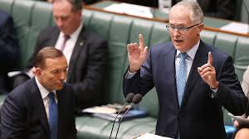
WHAT IS THE WESTMINISER SYSTEM?
https://www.youtube.com/watch?v=svMxNNBNisQ
Listen to Dr Ray White’s introduction to the Westminster System

Slide 10
Questions during viewing – please leave space for your answers
1. How does Dr Ray White describe the Westminster system?
2. Who is the head of state in the Westminster system?
3. Who does the Parliament comprise of?
4. Where is the Executive branch drawn from?
5. Why is it called the Westminster system?

Slide 11
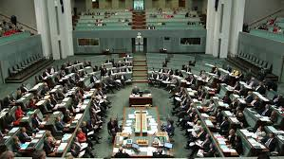
What are the key features of the Westminster system?
1. The Executive Branch: Drawn from Parliament and answerable to Parliament. Also called the Cabinet and made up of Ministers and the Prime Minister.
2. Head of Government: The leader of the Government, the Prime Minister.

Slide 12
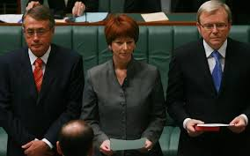
What are the key features of the Westminster system?
Head of state: Monarch who is ‘above politics’ and acts on advice from the Prime Minster. Can be represented by a Governor-General.
Elected representatives: People elected to represent the people. Often members of the lower house.

Slide 13
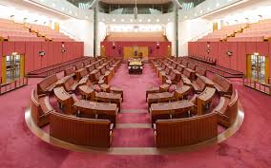
What are the key features of the Westminster system?
5. Government: Made by the political party with the most seats in the lower house.
6. Opposition: Made by the party with the second largest amount of seats in the lower house.
7. Rule of law: An independent court system to which the law applies to everyone.

